Slide 1
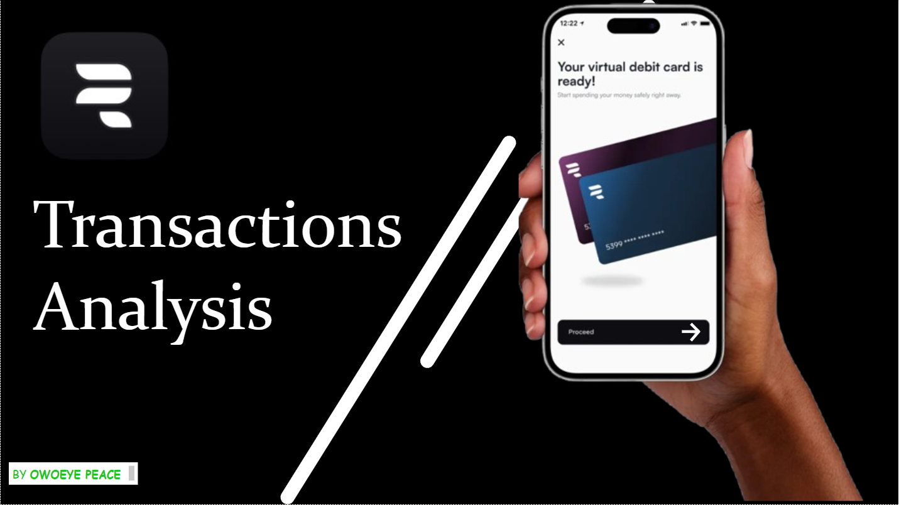
Rubies MFB Transaction Insights & Strategic Recommendations

Slide 2
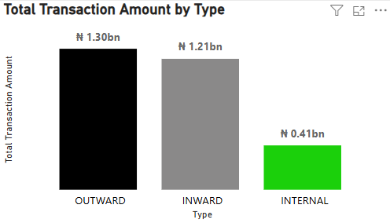
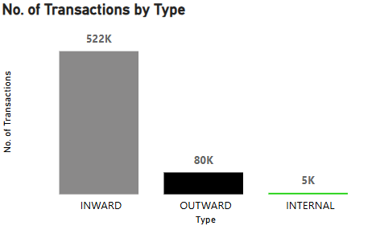
Overview of Transaction Trends
Between May 2024 and February 2025, Rubies processed over 600,000 transactions, totaling 2.92 billion in value.
At first glance, you would expect a significant amount of money to remain within the bank. However, what we see is the opposite—money leaving the bank exceeds both inward and internal transactions.
This brings us to a crucial question: Why is this happening?

Slide 3
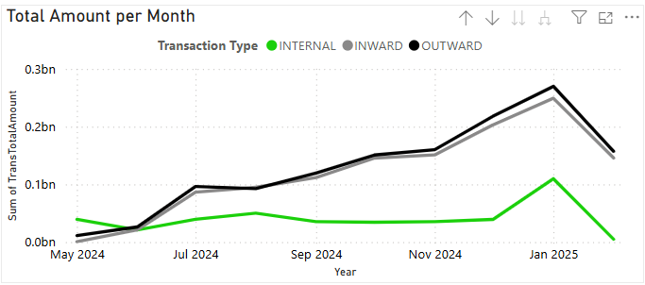
Monthly Transaction Patterns
Looking at our transaction trends over time, we see steady growth throughout the year, with a sharp spike from November to December.
Why? This is likely due to seasonal tourist inflows, particularly around December 30, when we observed our highest transaction volumes. However, this increase was temporary, with numbers returning to normal by February as seasonal customers left.
This pattern suggests that while we benefit from seasonal activity, our long-term customer engagement remains a concern.

Slide 4
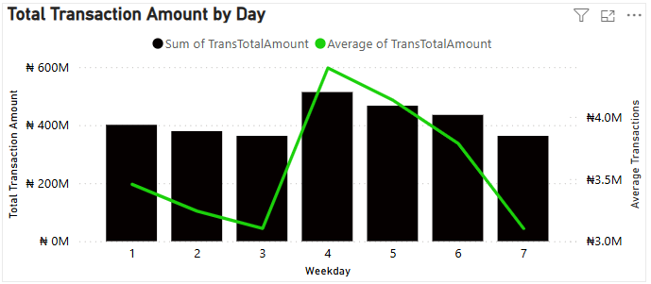
Weekly Spending Behavior
Transaction volumes peak on Thursdays before declining over the weekend.
Why Thursdays?
Weekend preparation—People stock up on essentials like food, clothing, and entertainment.
Retail and promotional strategies—Markets and businesses target Thursday for sales, encouraging more spending.
This insight presents an opportunity: How can we leverage these behavioral trends to drive more deposits and engagement?

Slide 5
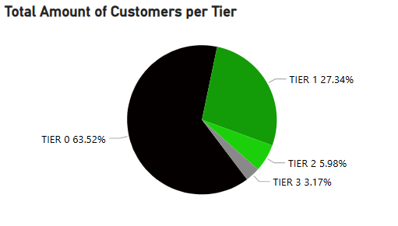
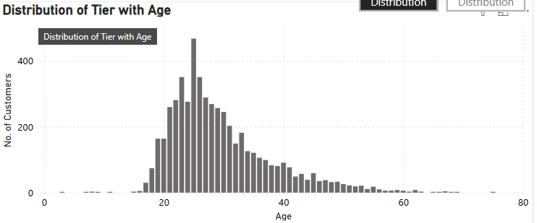
Customer Retention & Engagement Challenges
While we have a large customer base of 13,000 users across three countries, there is a significant issue:
63% of accounts maintain a Tier 0 status
Only 3% of customers are Tier 3 (our most engaged users)
The majority of active users fall into Tier 0 (minimal engagement)
Our key demographic is the 20–40 age range, yet they are not fully utilizing our banking services
This data highlights a core issue: Customers are transacting, but they are not keeping their money within the bank and fully committing to our services.
So, how do we address this?

Slide 6
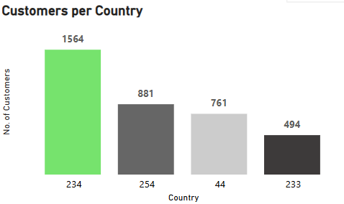
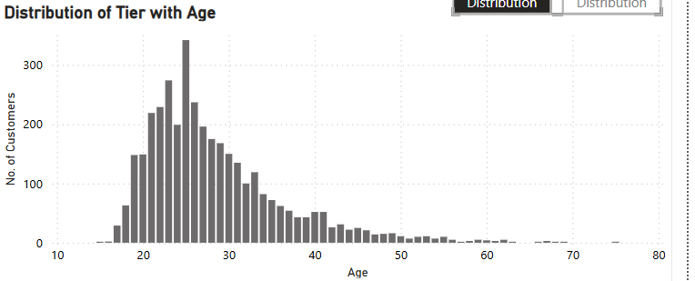
Strategic Recommendations
1. Customer Research & Feedback
Launching surveys and focus groups targeted at the 20–40 age group to identify their needs and concerns.

Slide 7
Strategic Recommendations
2. Retention & Investment Strategies
Introduce tailored financial products, such as savings incentives and investment accounts, to encourage deposits.
Offer benefits for internal transactions, like zero-fee transfers within the bank, to keep money circulating internally.

Slide 8
Strategic Recommendations
3. Marketing & Engagement Tactics
Leverage our Thursday peak by launching mid-week promotional campaigns to encourage deposits and engagement.
Offer personalized banking solutions to build long-term loyalty.

Slide 9

Conclusion
Rubies processes billions, but money leaves. We must understand customers, improve incentives, and boost engagement to drive growth.

Slide 10
Appendix (Dashboard)

Slide 11
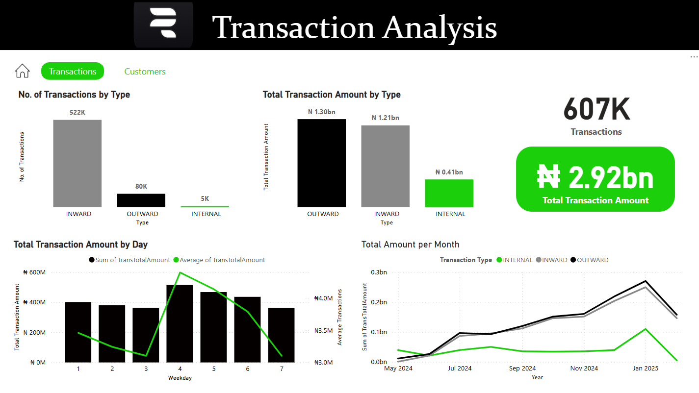

Slide 12
